Slide 1
Detection of Advance Persistent Threat in online social network using Honeypots
Submited to Submited by:-
Mrs. Leena Singh Shreya Gupta
Rishabh Kumar
Yash Kaushik
Vibhor Kumar

Slide 2
Introduction
An Advanced Persistent Threat (APT) is a prolonged and targeted cyberattack.
An intruder gain access to a network and remains undetected for an extended period of time.
It incorporate advanced methods for evading current security mechanism.

Slide 3
How APT Is Different From Traditional Threats
Traditional threats, such as viruses and malware that are repurposed for attacking different systems or companies
An APT are carefully planned and designed with the goal of attacking one specific company or organization.

Slide 4
Existing problem
Advanced attackers make use of online social networks (OSNs) in order to extract useful information and establish contact with company employees as potential entry points into the organization

Slide 5
OBJECTIVE
To propose a social network honeypots as a means of analysing friend’s sentiment .
To Secure one’s account by checking their password strength.
To inform all the friends about their trapped password .

Slide 6
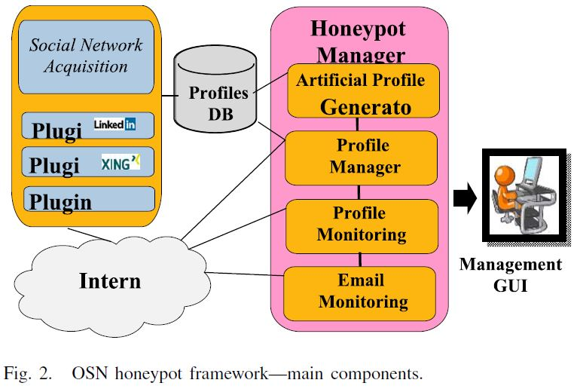
System Architecture

Slide 7
Approach
The use of OSN api to interact with various OSN like tweeter.
Pull the data from tweeter like friends information and their possitive,neggative and neutral count by analyzing their tweets.
This will give the information about how many people like or dislike them.
Generate the data in table form(Dashboard).
Security Part:-
Check the password sterngth of user by passing the various general combination of password .

Slide 8
Try to login in the friends account by passing these password combination and on the sucessful login extract the phone no. from user’s account to give them the information about their password strength.
List the no. of trapped users.

Slide 9
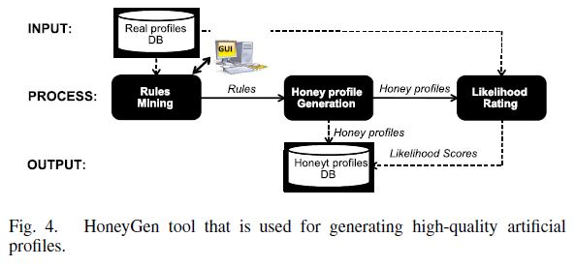
Summary

Slide 10
Dashboard

Slide 11
Graph Showing user’s Name and their Friends

Slide 12
References
[1] Abigail Paradise, Asaf Shabti,Rami Puzis, Aviad Elyashar, “”Creation and Detection of Social Network Honeypots for Detecting Targeted Cyberattack”, IEEE Transactions on Computational Social Systems,pp:1-15,2017
[2] R. Jasek, M. Kolarik, and T. Vymola, “APT detection system using honeypots,” in Proc. 13th Int. Conf. Appl. Informat. Commun. (AIC),pp:25-29, 2013.
[3] A. Paradise, R. Puzis, and A. Shabtai, “Anti-reconnaissance tools: Detecting targeted socialbots,” IEEE Internet Comput., vol. 18, no. 5, pp. 11-19, 2014.
[4] M. Ask, P. Bondarenko, J. E. Rekdal, A. Nordbø, Ruthven, and P. B. Nordbo “Advanced persistent threat (APT) beyond the hype,” Presented at the IMT4582 Netw. Secur. GjoviN Univ. College, 2013.

